Slide 1
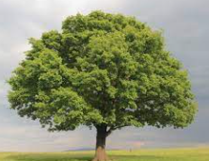
Welcome to Oak Class
From tiny acorns mighty oaks do grow.

Slide 3
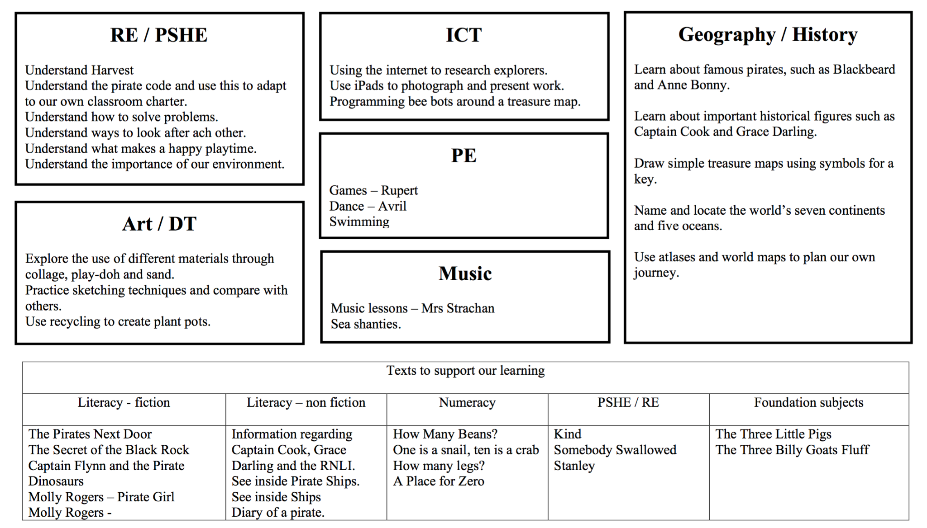

Slide 4
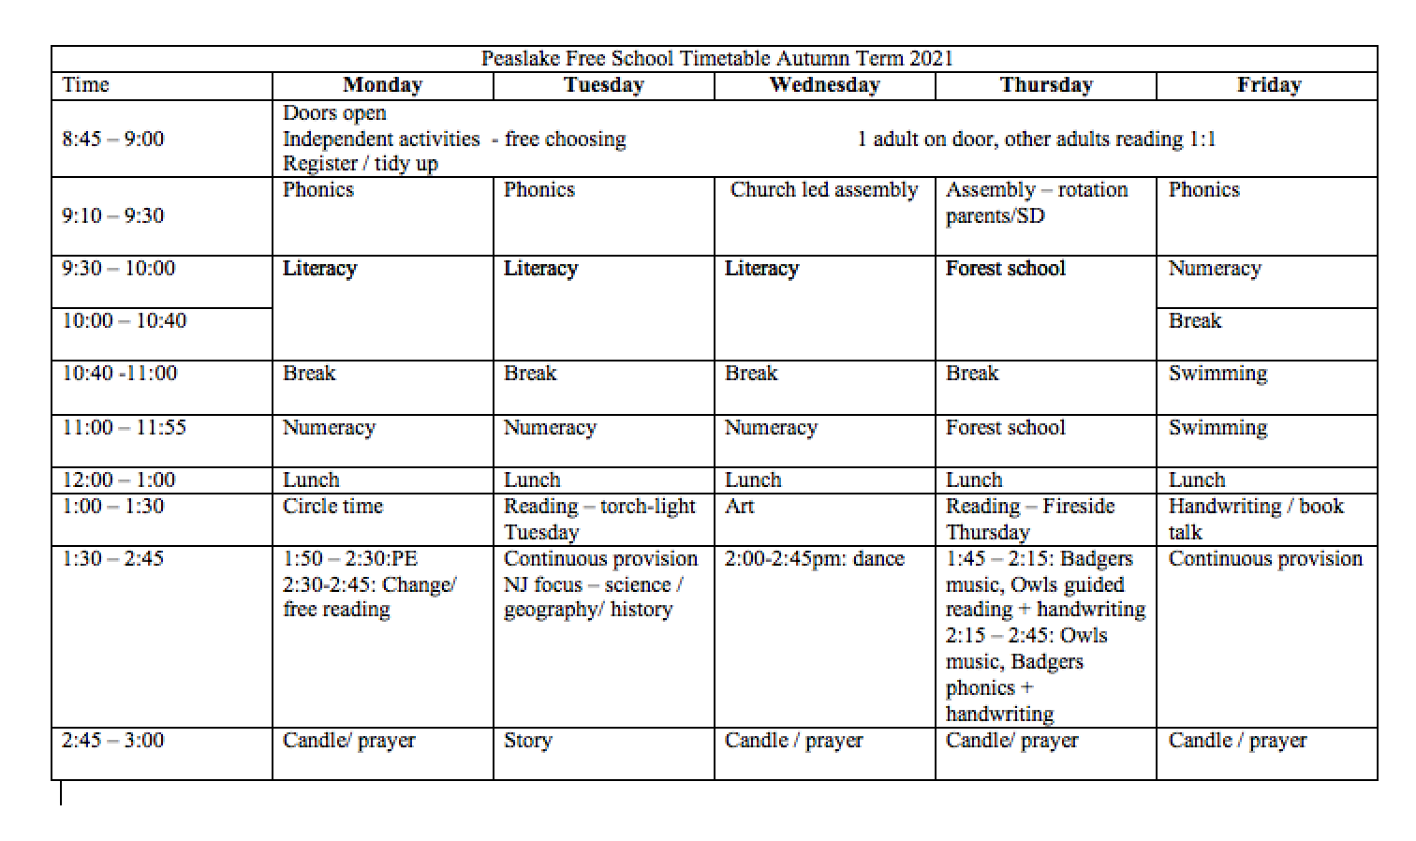

Slide 5
General information
Please ensure that your child has their reading folder daily. We will encourage the children to change their reading books on a Monday / Wednesday and Friday. They will be read with at least once a week with an adult. Sometimes this may be in the form of assessing their reading level or phonics.
Zoom assemblies will be at 9:20am every other week. Next one: 23rd September. These will be recorded. Unfortunately we are unable to admit late entrants.
Homework will be set weekly via Google Classrooms.
Reading at home can also be accessed via Oxford Owls.

Slide 6
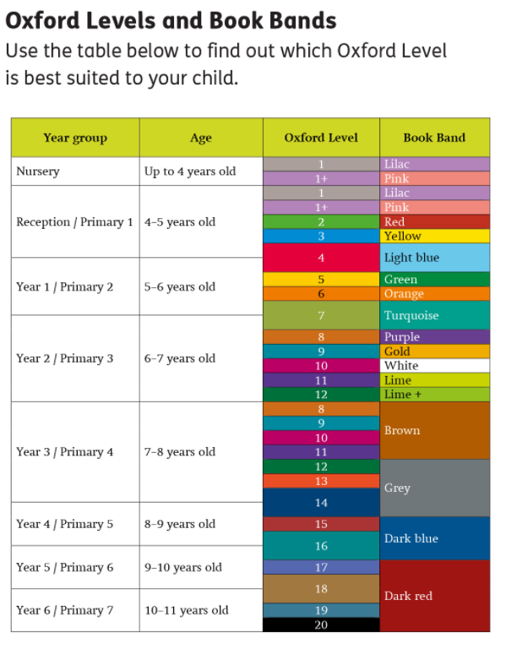
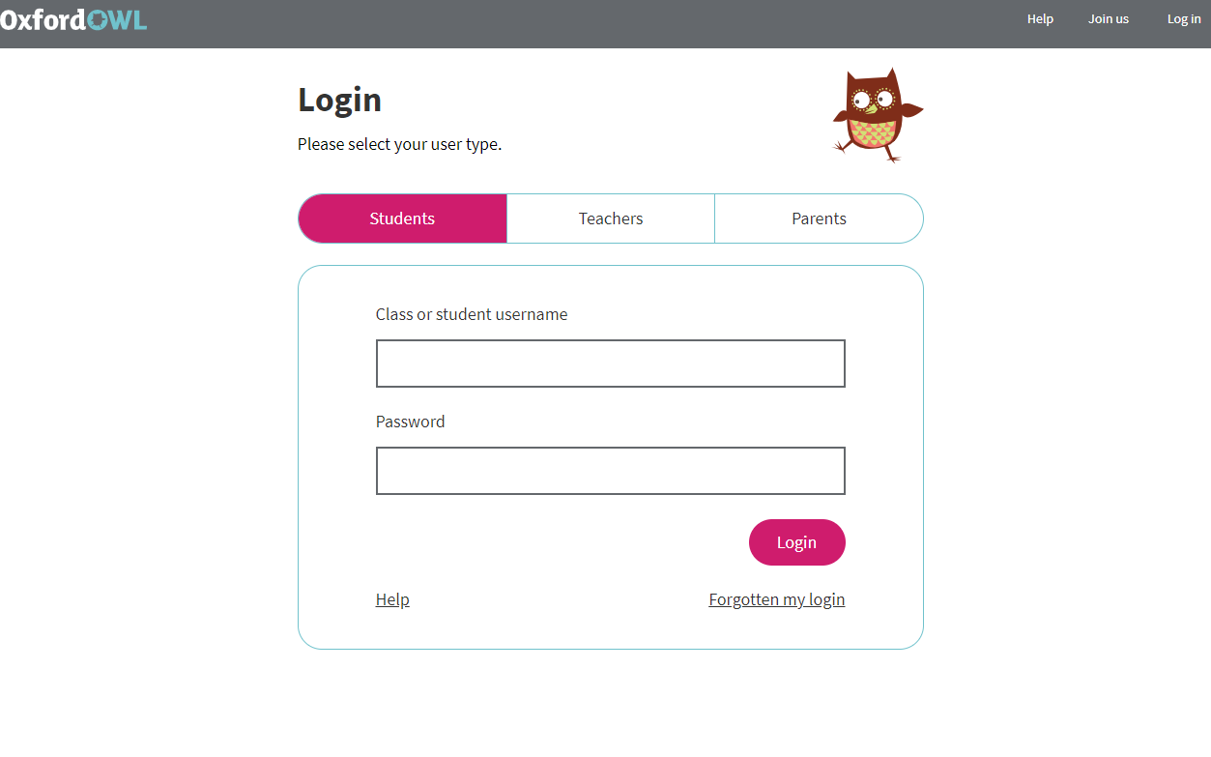

Slide 7
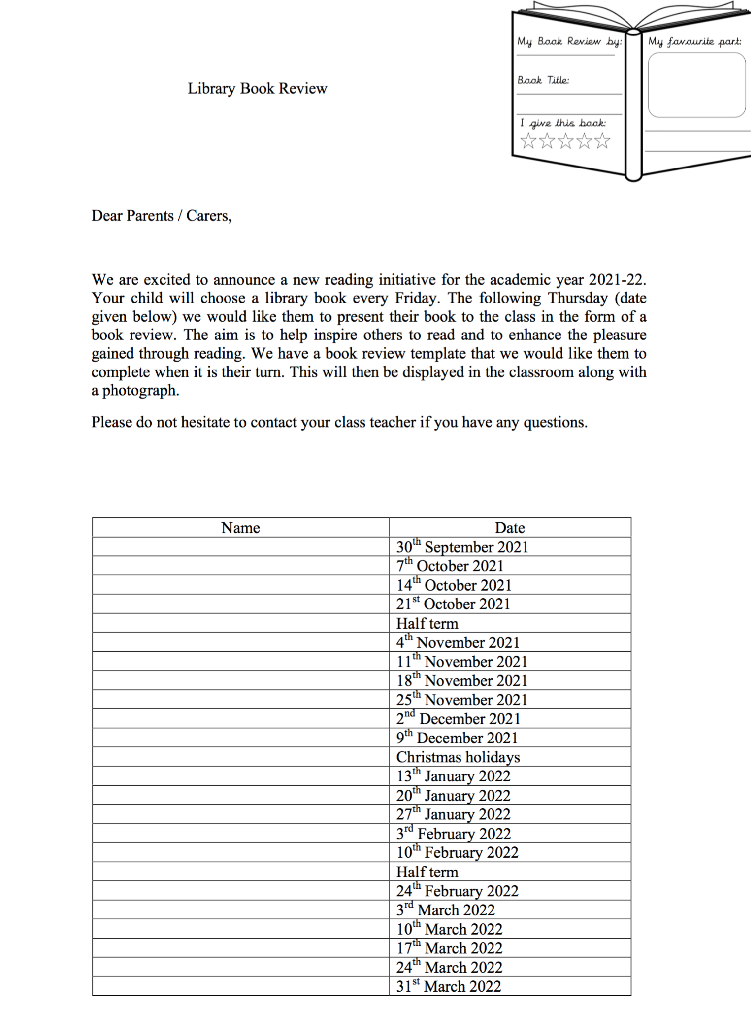
Library books

Slide 8
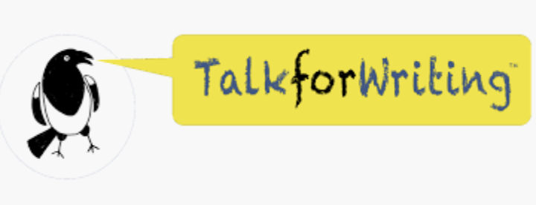
Curriculum

Slide 9
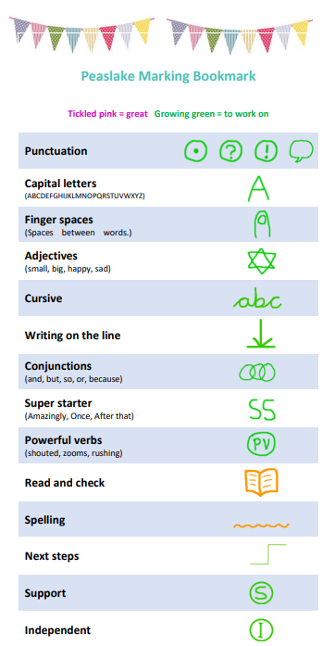

Slide 10
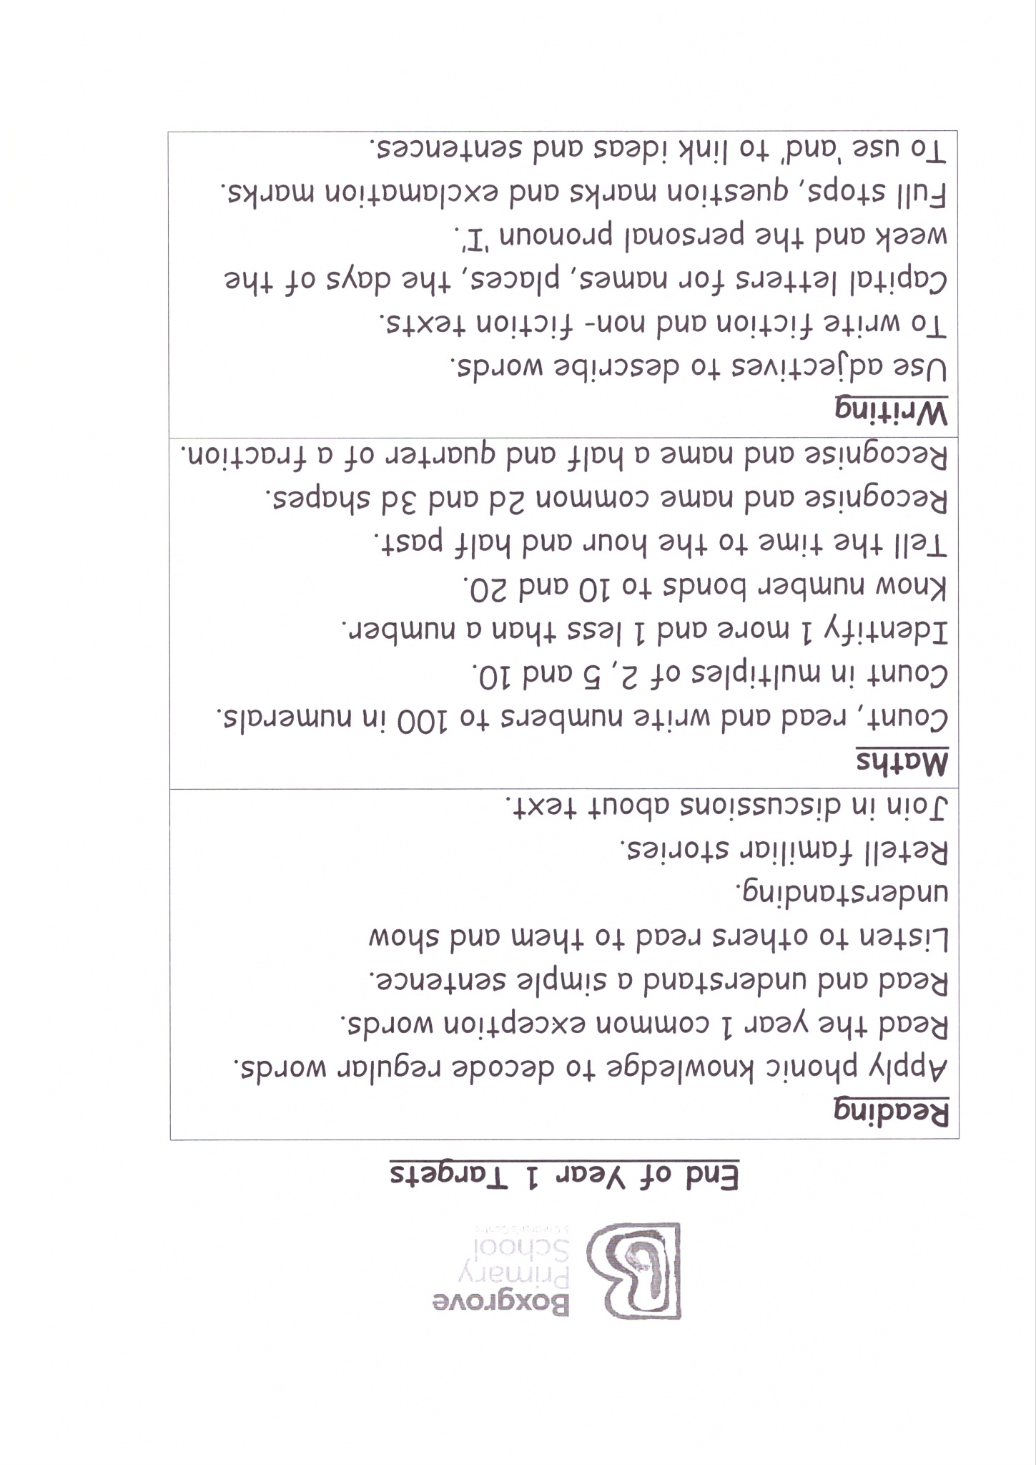

Slide 11
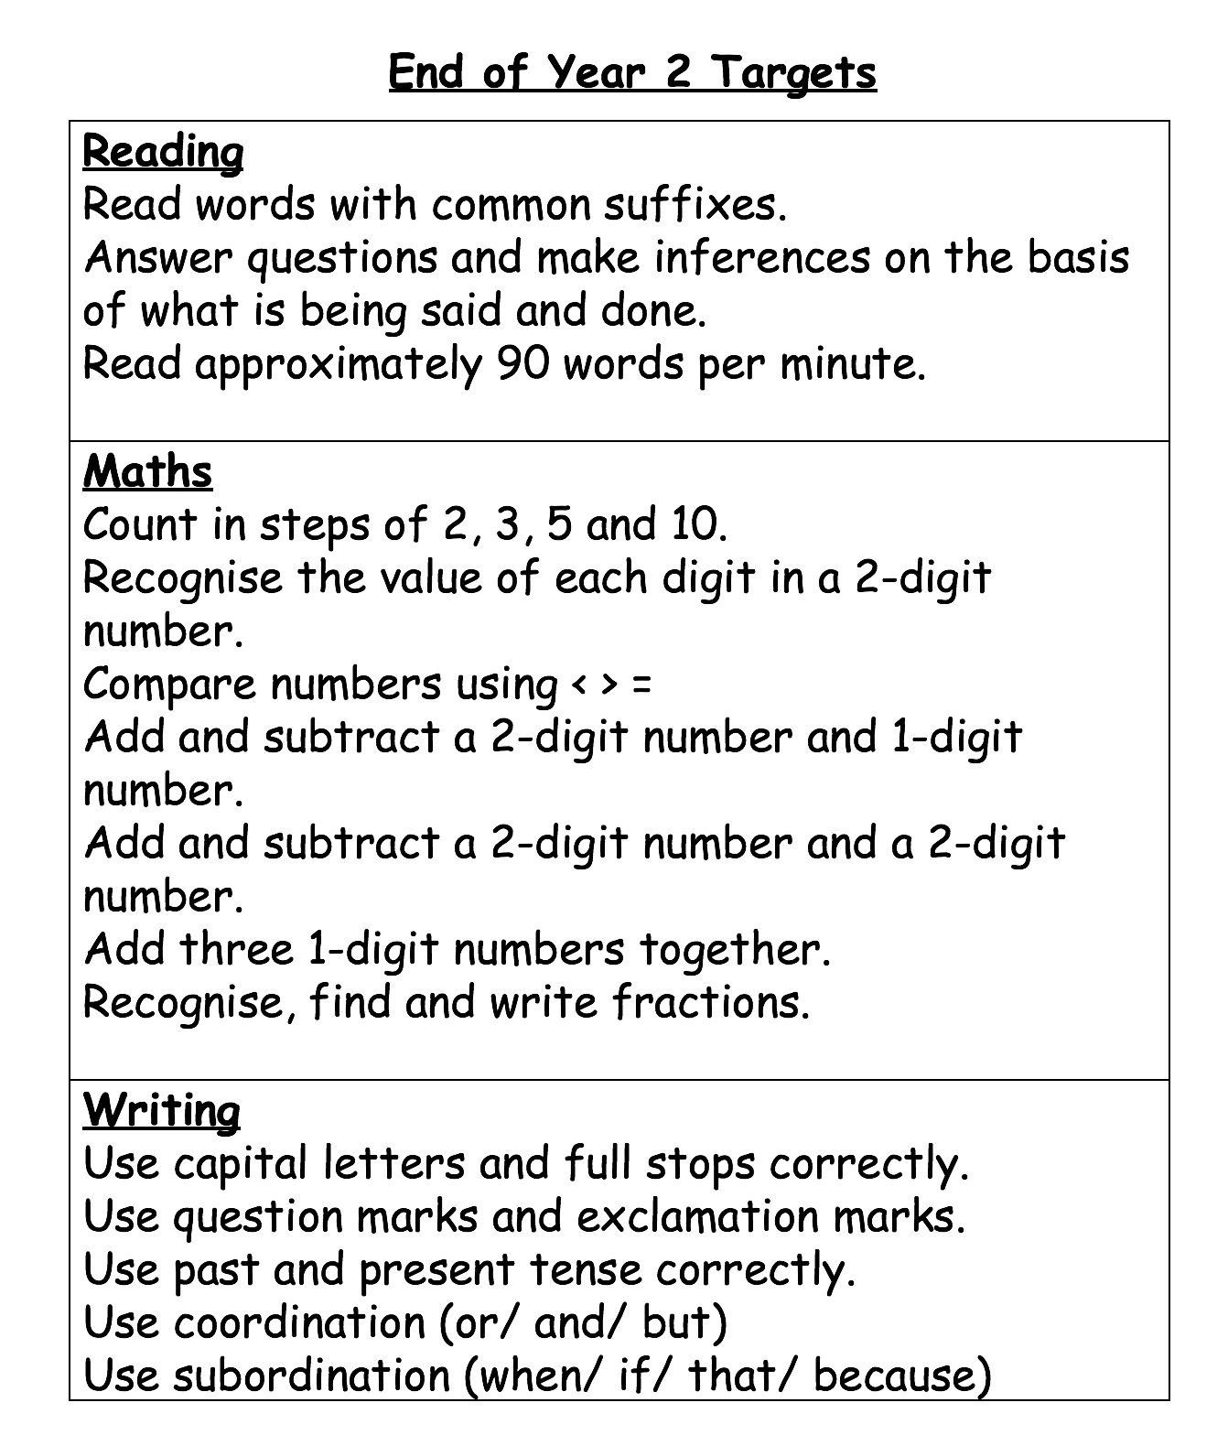

Slide 12
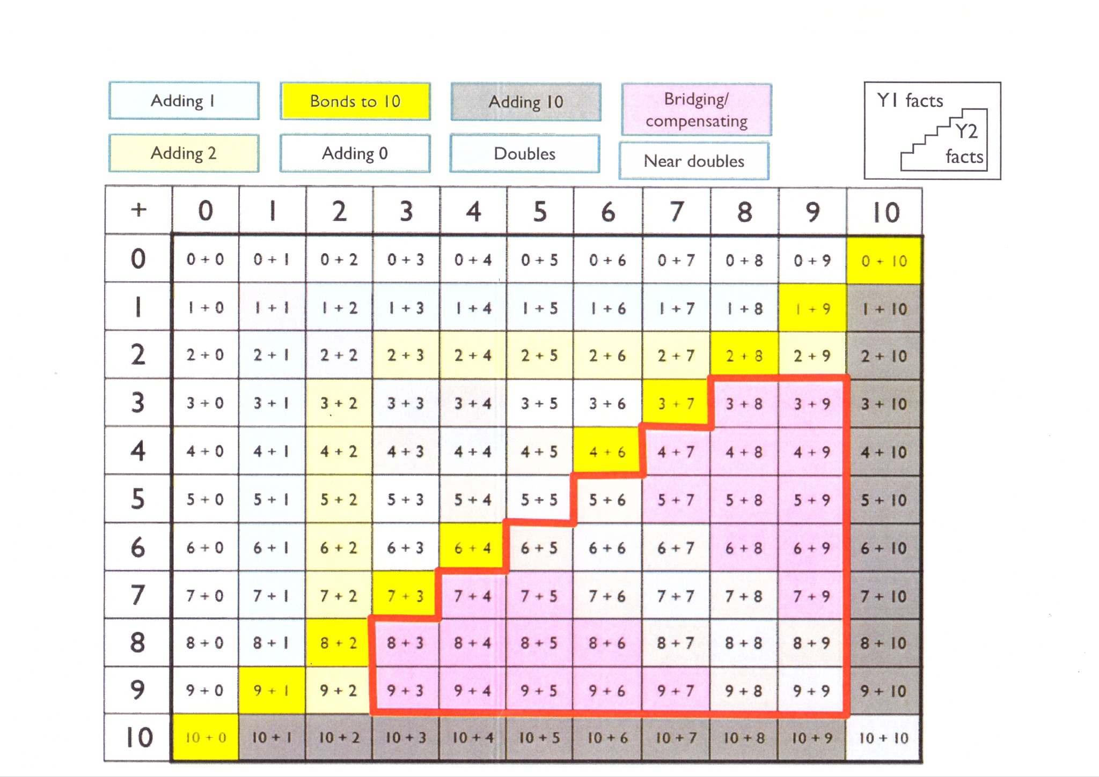

Slide 13
Numeracy outline

Slide 14
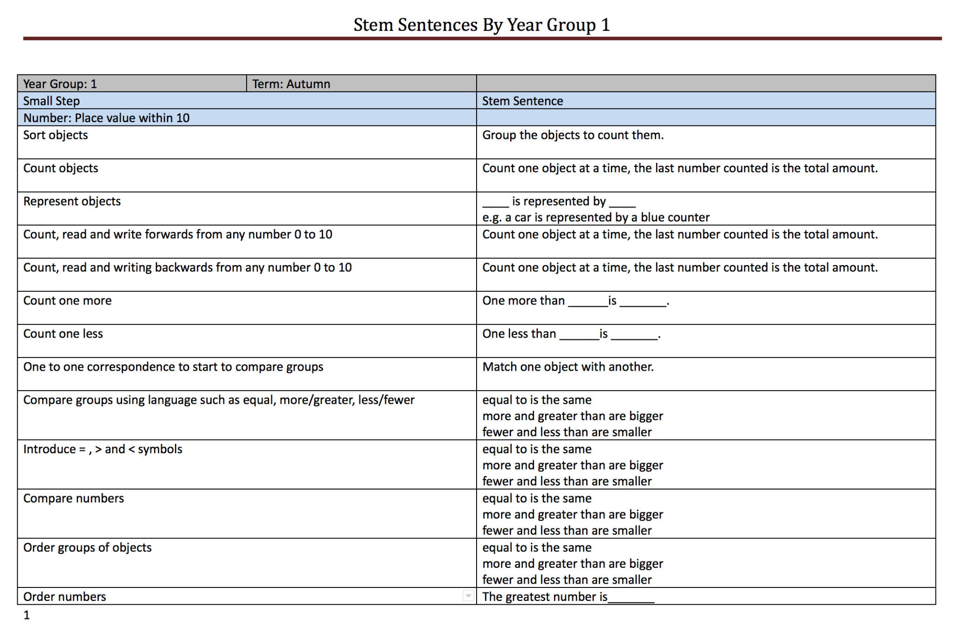
Example of mathematical language:

Slide 15
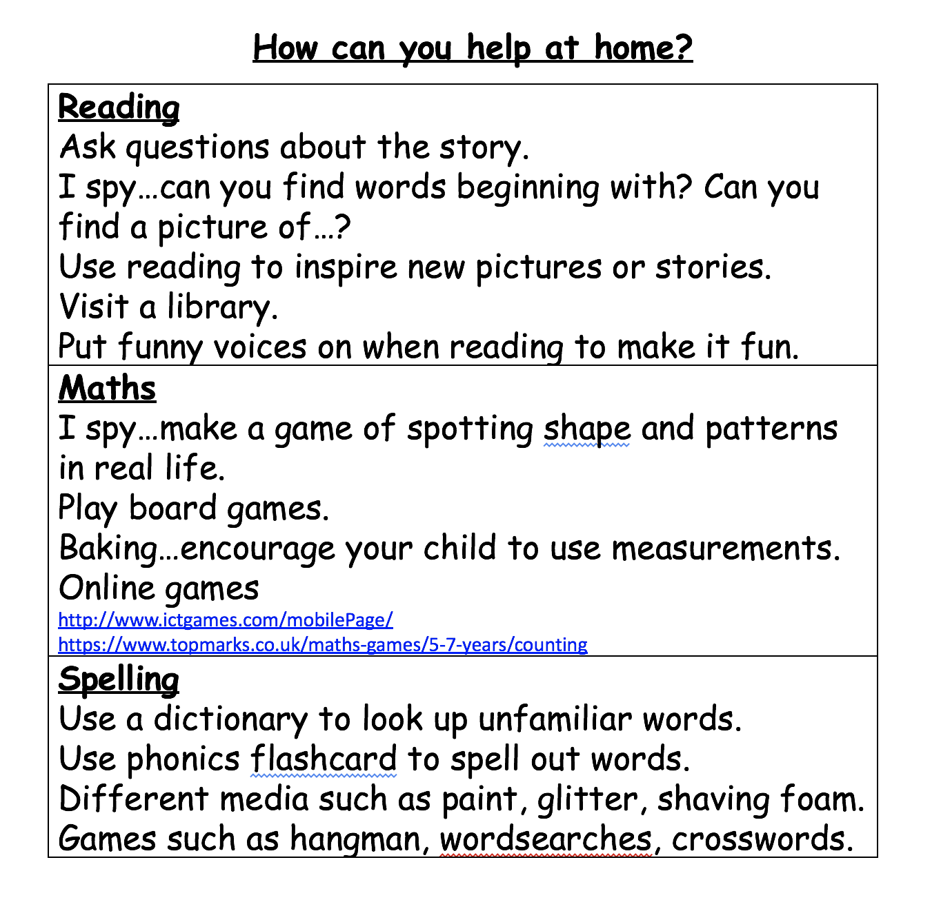
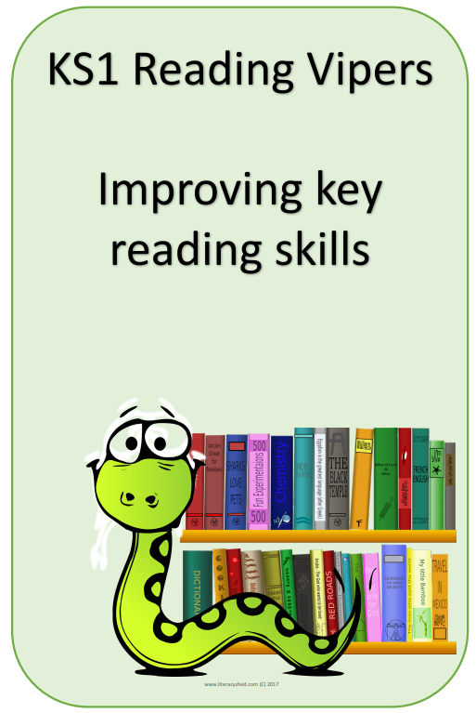
Maths:
https://whiterosemaths.com/for-parents/

Slide 16
Information available on Google Classrooms:
Reading VIPER questions and examples
Numeracy stem sentences for Year 1 and Year 2
Supporting your child with their expressive language - Surrey S&L
Common exception words Y1 and Y2
Understanding a maths mastery approach PDF (training directed at professionals but may provide a useful insight to parents/ carers)

Slide 17
Thank you for listening.
Any questions?

