Slide 1
Welcome to Hazel Class
Hazel - the tree of wisdom and knowledge.

Slide 2
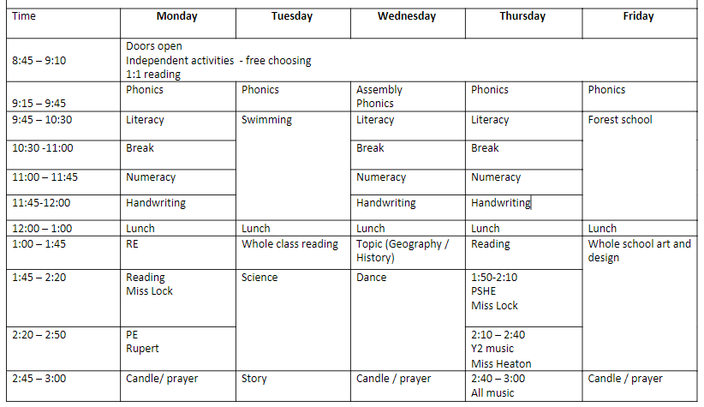

Slide 5
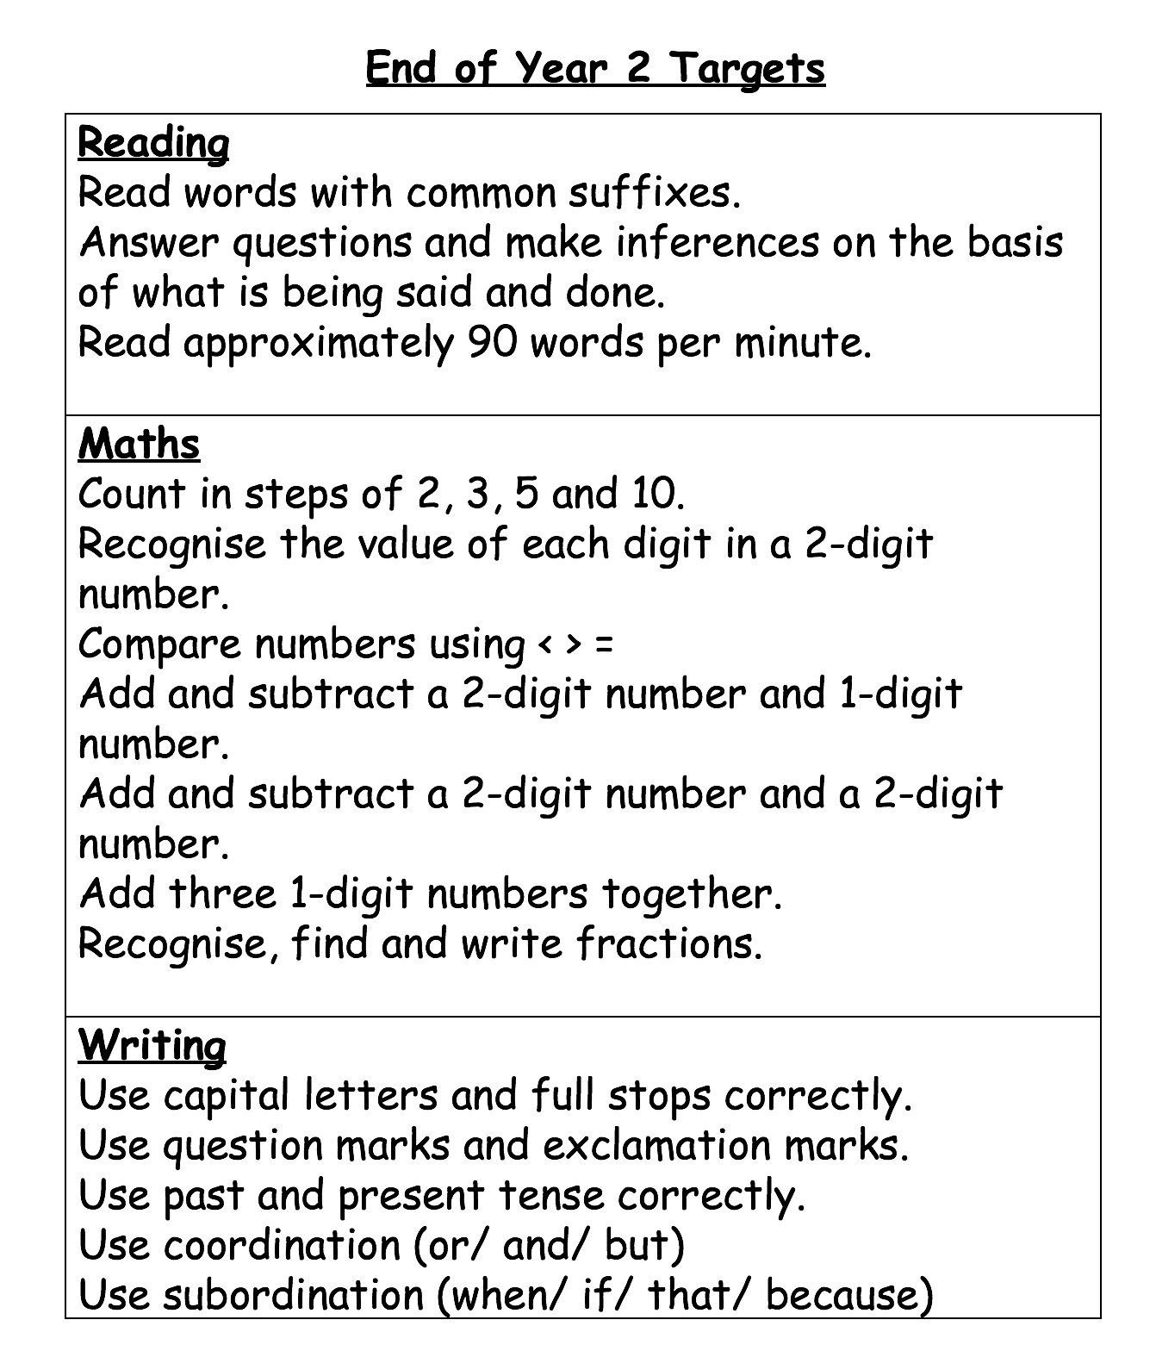

Slide 6
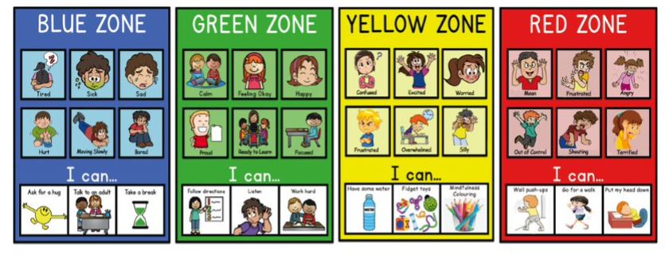
Classroom management – zones of regulation

Slide 7
What phonics will look like in Hazel Class
Initially we will re-cap the Phase 5 sounds using the Little Wandle format.
Little Wandle scheme currently goes to Phase 5.
Following this, we will move on to the Phase 6 Twinkl Scheme.
Children learn 2 new tricky words per week.
Children focus on either a new sound or spelling rule per week.

Slide 8
What literacy will look like in Hazel Class
Each half term there will be a fiction and non-fiction focus to our whole class learning.
We will use talk for writing to imitate and the innovate stories.
Within our lessons, we will focus on the five areas of language (attention and listening, conversation, storytelling, sentence building, vocabulary)
Activities will include sequencing stories, drama, posters.
We will build up to shared writing and then independent.
Children are supported with word mats on their table.
Children will also have their own 'thoughts and ideas' books to write stories of their own choosing during self-directed learning time.
Independent writing will also be encouraged across the curriculum
We will use our marking policy to start to self-edit our work.

Slide 9
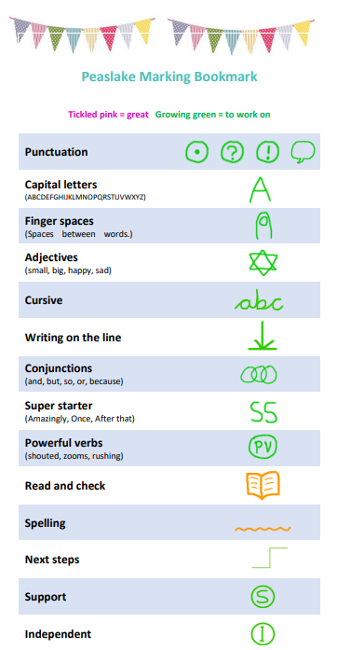

Slide 10
What reading will look like in Hazel Class
3 weekly group sessions focusing on de-coding, prosody and comprehension.
1:1 reading throughout the week with class teacher and reading volunteers.
Autumn 1 will focus on Little Wandle Phase 5 books, changing weekly.
After review, the intention for Autumn 2 onwards will be to read short chapter books together.
Books to be sent home
In Autumn 1 the children will have 2 books:
1 – Little Wandle book changed weekly
2 - A book from the banded reading scheme – to be changed independently by the children at their leisure.
Communication with parents will continue with reading record journals.
5 home entries = 1 treasure chest point
All books must be in school daily to ensure that our reading can take place.

Slide 11
What numeracy will look like in Hazel Class
We will follow the Year 2 curriculum, using the White Rose Scheme of learning.
We will use the format of concrete --> pictorial --> abstract to adopt a mastery approach.
This may mean that some days there are no entries within books if in the 'doing' stage.
We will use stem sentences to help with our mathematical vocabulary.
All children will have access to maths written challenges in the classroom.

Slide 12
Year 2 assessments
For those who did not pass the phonics screening in Y1, they will have another attempt in this accademic year.
There will be statutory assessments for all Year 2 children at the end of the academic year.
We will undertake our termly PiRA and PUMA papers in Year 2.
Benchmarking for reading will take place at intervals over the year.

Slide 13
Homework – google classrooms
Weekly homework will be set on a Friday using google classrooms.
Normally, there will be 2 tasks – one numeracy and one literacy.
I will also provide an outline of the week's phonics lessons so that you can practise the sound / common exception words / grammar focus.

Slide 14
Further information available on google classrooms
Y1/2 common exception words
KS1 VIPER questioning to help with reading comprehension
Ideas for practical phonics games
Stem sentences for Y2 numeracy
Additional resources:
https://whiterosemaths.com/parent-resources
https://www.littlewandlelettersandsounds.org.uk/resources/for-parents/ (recap phonics / reading)

Slide 15
https://collins.co.uk/pages/collins-big-cat-little-wandle-letters-and-sounds-revised-ssp For any child who may need support with phase 5 sounds at home.

