Slide 1
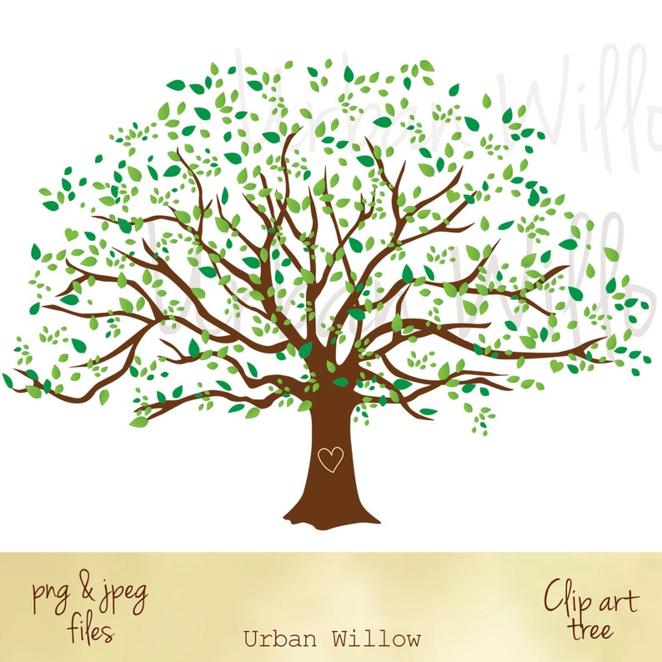
Welcome to Oak Class
Oak- the tree of wisdom, strength and resilience.

Slide 2
September timetable
9:15-9:45 | Phonics | phonics | Assembly/phonics | phonics | phonics
9:45-9:50 | Wake up, shake up | Wake up, shake up | Wake up, shake up | Wake up, shake up | Wake up, shake up
9:50-10:30 | Continuous provision/ group work (literacy) | Continuous provision/ group work | Continuous provision/ group work | Continuous provision/ group work | Swimming
10:30- 11:00 | Break | Break | Break | Break
11:00-12:00 | Numeracy/Group work | Numeracy/Group work | Numeracy/Group work | Numeracy/Group work
12:00-1:00 | Lunch | Lunch | Lunch | Lunch | Lunch
1:00-1:45 | RE | Whole class reading | Topic (History/Geography) | Reading | Whole school art and design
1:45-2:20 | Reading | Reading/ Science | Dance | 1:50-2:10 PSHE 2:10-2:40 Music-Miss Heaton
2:20- 2:50 | PE Rupert | Science | Dance
2:45-3:00 | Candle/prayer | Story | Candle/prayer | 2:40-3:00 All music | Candle and prayer
Time | Monday | Tuesday | Wednesday | Thursday | Friday
8:45-9:10 | Doors open Register, independent activities- picture writing, handwriting, free choosing 1:1 Reading

Slide 3
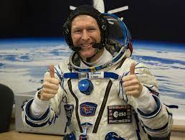
Literacy:
We will listen to simple stories, including non-fiction, poetry and fables.
The story of "The Three Little Pig" will form the basic of a "talk for writing" style unit of fictional writing during Autumn 1.
Within phonics we will review phase 3 and 4 sounds and move to phase 5.
We will continue with our group reading sessions, exploring de-coding, prosody and comprehension.
In Autumn 1, we will use the Little Wandle phase 4 set 4 books.
Our grammar focus will include: Capital letters, full stops, adjectives and noun phrase.
Autumn Term Oak Class
Movers and Shakers
This project teaches children about historically significant people who have had a major impact on the world. They will learn to use the timeline, stories and historical sources to find out about the people featured and use historical models to explore their significance.
Maths:
Place value:
WE will
Count forwards and backwards initially within 20, then 50.
Compare numbers within 50.
Recognise and represent numbers to 100.
Counting one more and one less.
Introducing <, > and= symbols.
Compare and order objects and numbers.
Use a number line
Addition and subtraction:
Introduce the part whole model.
Understand number bonds to 10.
Understand the concepts of addition and subtraction, their symbols and how to link these to fact families.
RE:
Who is Jesus?
Why did Jesus tell parables?
Why is Harvest celebrated world wide?
Islam
What is important for Muslim families?
(Trip to Mosque)
In what way is the mosque special to Muslims.
PSHE:
We will re-cap our zones of regulation and how best to manage our emotions.
We will focus on relationships, listening to other's ideas, playing and working cooperatively.
We will the importance of rules.
We will recap on keeping safe online.

Slide 4
Science:
Identify and name a variety of common animals that are birds, fish, reptiles, mammals and invertebrates.
Identify and name a variety of animals that are carnivores, herbivores and omnivores.
Identify and name a variety of plants and animals in their habitats.
Describe and compare the structure of a variety of common animals.
To know which part of the body is associated with each other.
Weekly forest school sessions will provide the opportunity to focus on seasonal change over time.

Slide 5
End of year 1 Targets
Reading:
Apply phonics knowledge to decode regular words.
Read the year1 common exception words.
Read and understand a simple sentence.
Listen to others read to them and show understanding.
Retell familiar stories.
Join in discussions about text.
Maths:
Count, read and write numbers to 100 in numerals.
Count in multiples of 2, 5 and 10.
Identify 1 more and 1 less a number.
Know number bond to 10 and 20.
Tell the time to the hour and half past.
Recognise and name common 2d and 3d shapes.
Recognise and name a half and quarter of a fraction.
Writing:
Use adjectives to describe words.
To write fiction and non-fiction texts.
Capital letters and names, places, the days of the week and the personal pronoun “I”.
Full stops, question marks and exclamation marks.
To use :and: to link ideas and sentences.

Slide 6
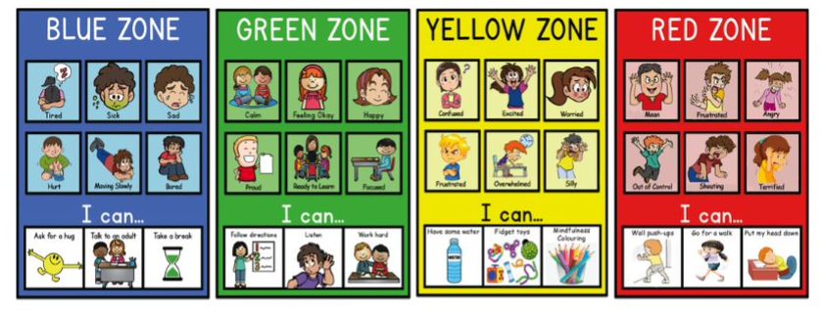
Classroom management – zones of regulation

Slide 7
What phonics will look like in Oak Class
Initially we will re-cap the Phase 3-4 sounds using the Little Wandle format.
Learning phase 5 sounds.
Little Wandle scheme currently goes to Phase 5.
Children learn 4/5 new tricky words per week.
Children focus on new sounds every week and review previous ones.
Children focus on spelling 2/ 3 words every week.

Slide 8
What literacy will look like in Oak Class
Each half term there will be a fiction and non-fiction focus to our whole class learning.
We will use talk for writing to imitate and the innovate stories.
Within our lessons, we will focus on the five areas of language (attention and listening, conversation, storytelling, sentence building, vocabulary)
Activities will include sequencing stories, drama, posters.
We will build up to shared writing and then independent.
Children are supported with word mats on their table.
Children will also have their own 'thoughts and ideas' books to write stories of their own choosing during self-directed learning time.
We will use our marking policy to start to self-edit our work.

Slide 9
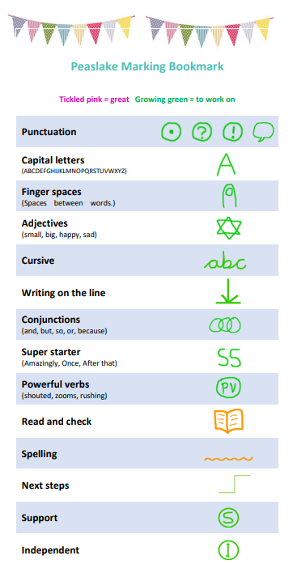

Slide 10
What reading will look like in Oak Class
3 weekly group sessions focusing on de-coding, prosody and comprehension.
1:1 reading throughout the week with class teacher and reading volunteers.
Autumn 1 will focus on Phase 4 set 5 books.
After review, the intention for Autumn 2 onwards will be to read short chapter books together.
Books to be sent home
In Autumn 1 the children will have 2 books:
1 – Little Wandle book changed weekly
2 - A book from the banded reading scheme – to be changed independently by the children at their leisure.
Communication with parents will continue with reading record journals.
5 home entries = 1 treasure chest point
All books must be in school daily to ensure our reading can take place.

Slide 11
What numeracy will look like in Oak Class
Independent thinkers and independent learners.
Making number work fun maths
We will follow the Year 1 curriculum, using the White Rose Scheme of learning.
We will use the format of concrete --> pictorial --> abstract to adopt a mastery approach.
This may mean that some days there are no entries within books if in the 'doing' stage.
All children will have access to maths written challenges in the classroom.
Children will develop their mathematical thinking skills and will be able to solve word problems.

Slide 12
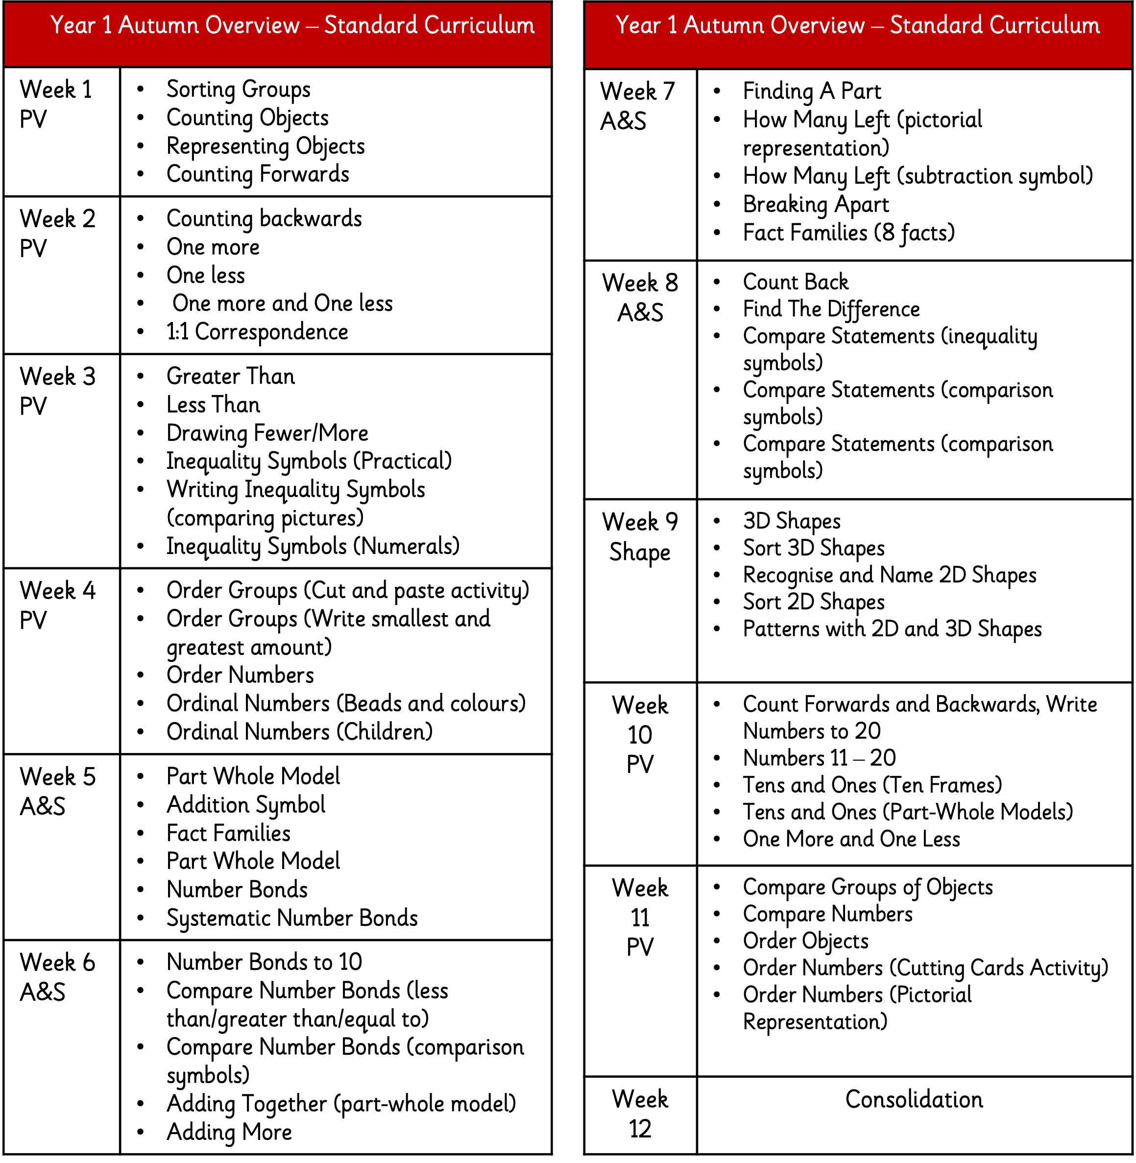

Slide 13
Year 1 assessments
The phonics screening in Y1 will be in Summer 1 -2023.
We will undertake our termly PiRA and PUMA papers in Year 1.
Benchmarking for reading will take place at intervals over the year.

Slide 14
Homework – google classrooms
Weekly homework will be set on a Friday using google classrooms.
Normally, there will be 2 tasks – one numeracy and one literacy.
I will also provide an outline of the week's phonics lessons so that you can practise the sound /tricky words / grammar focus (later on).

Slide 15
Further information available on google classrooms
Y1 tricky words
Ideas for practical phonics games.
Additional resources:
https://whiterosemaths.com/parent-resources
https://www.littlewandlelettersandsounds.org.uk/resources/for-parents/ (recap phonics / reading)

Slide 16
https://collins.co.uk/pages/collins-big-cat-little-wandle-letters-and-sounds-revised-ssp For any child who may need support with phase 2-4 sounds at home.

